Slide 1




Workshop
Fixed Asset
PT Soltius Indonesia
SOHO CAPITAL @ Podomoro City
15th Floor, Suite SC-1503-05
Jl. Letjen. S. Parman Kav. 28,
Jakarta Barat 11470 - Indonesia
Office : +62 21 2934 5900

Slide 2

Agenda
  Asset Setting
    Asset Class
    Depreciation Type
    Account Determination
  Asset Master Data
    Creating Asset Master Data
  Capitalization
    Recognition of Asset Values
  Depreciation
    Asset value depreciation
  Fiscal Year Change
    Asset value Yearly Closing
Workshop

Slide 3

Asset
Settings
Workshop

Slide 4




SAP Business One Asset Settings Concepts
Asset Class
Depreciation Type
Account Determination

Slide 5
SAP Business One Asset Settings Concepts
Asset Class
Depreciation Type
Account Determination
To determine Asset Type & Asset Useful Life
To determine Deprecation Type (Straight Line or Double Declining)
To determine Account to use when user execute FA Transaction such as Acquisition, Retirement, etc

Slide 6
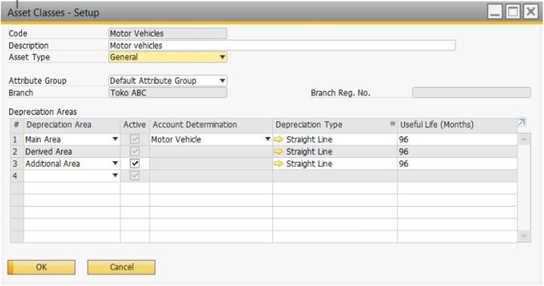
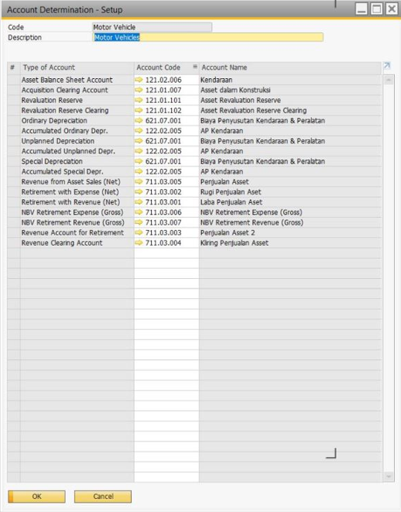
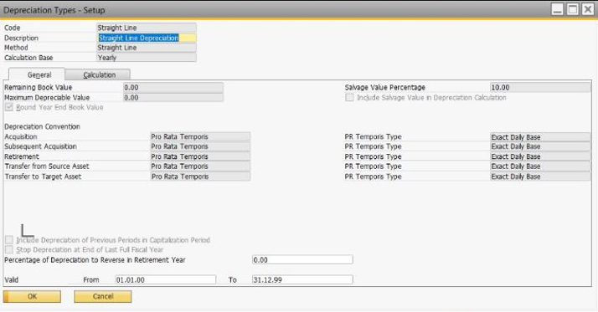
SAP Business One Asset Settings Examples
Asset Classes
Depreciation Types
Account Determination

Slide 7
Asset
Master Data
Workshop

Slide 8
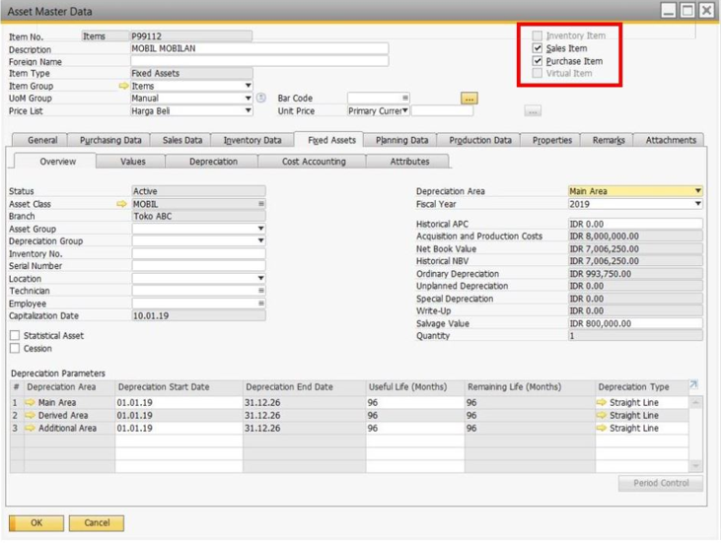

SAP Business One Asset Master Data
Creating Asset Master Data
Asset Code
Sales Item
Asset Name
Asset Class
Please pay attention to the following points when creating Asset Master Data

Slide 9
Asset
Capitalization
Workshop

Slide 10
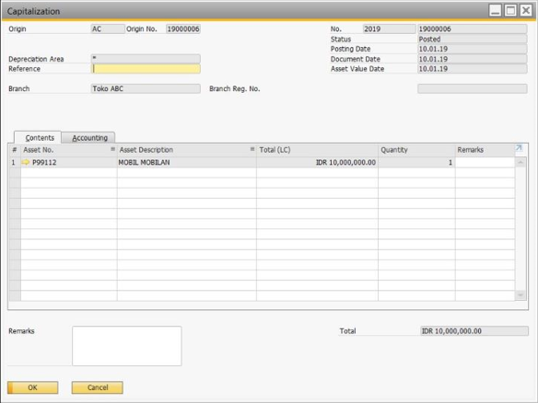
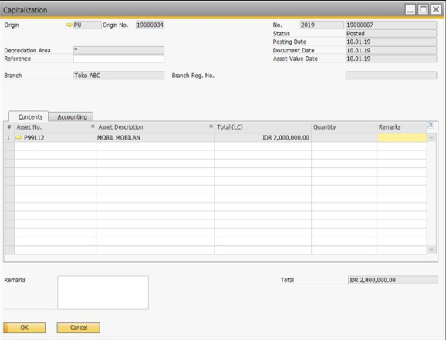
SAP Business One Capitalization
Recognition of Asset Values
Capitalization
A/P Invoice

Slide 11
Asset
Depreciation
Workshop

Slide 12
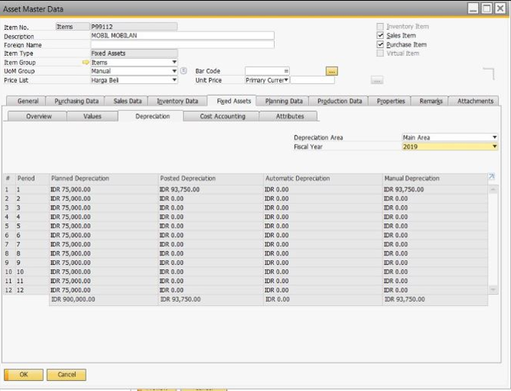
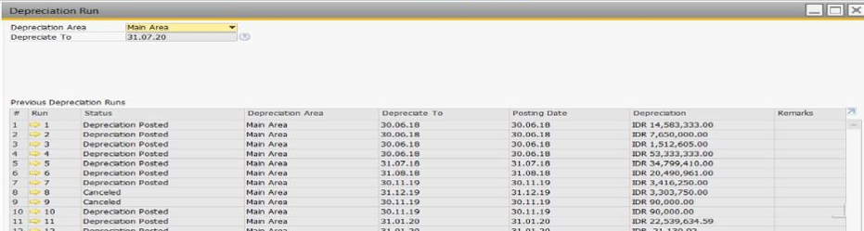
SAP Business One Depreciation
Asset Values depreciation
Automatic
Manual

Slide 13
Asset
Fiscal year Change
Workshop

Slide 14
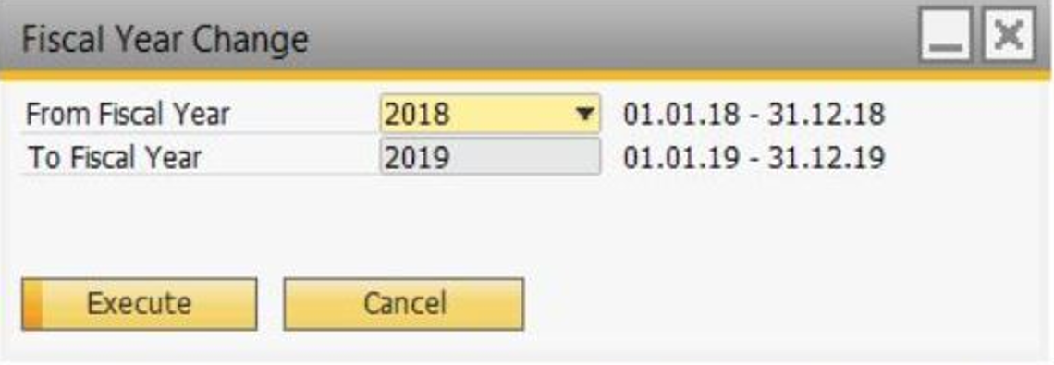
SAP Business One Fiscal year Change
Asset value Yearly Closing

Slide 15


