Slide 1



BACKUP PROCEDURES
PT SOLTIUS INDONESIA
SOHO CAPITAL @ PODOMORO CITY
15th Floor, Suite SC-1503-05
Jl. Letjen. S. Parman Kav. 28
Jakarta Barat 11470 - Indonesia
Office : +62 21 2934 5900

Slide 2
BACKUP REASONS
Your database is always subject to the risk of damage. There are many reasons why data might be lost or become corrupted:
Disks crash
Interruption of power supply
User mistakes
Virus damage
Fire or earthquake
Therefore, be sure to work out a security strategy that consists of a validated, and if possible certified backup and restore process.
Source SAP
Proprietary of PT Soltius Indonesia

Slide 3
BACKUP PURPOSES
Backups are required
To protect against disk failures
To make it possible to reset the database to an earlier point in time
Backups are also used for other scenarios such as database copies.
Source SAP
Proprietary of PT Soltius Indonesia

Slide 4
BACKUP TYPES
Instance
Schema / Database
Proprietary of PT Soltius Indonesia

Slide 5
INSTANCE BACKUP
Like any DBMS, full data backups of the whole HANA instance should be performed regularly for disaster recovery.
After a full data backup, the log backups before the latest full data backup can be checked for consistency, then deleted safely if no recovery to the earlier stage required.
Without regular full data backup and deleting older log backup, the log backup may keep growing up to full disk, which may result in outage of SAP HANA system.
Proprietary of PT Soltius Indonesia

Slide 6
SCHEMA / DATABASE BACKUP
Schema / Database Backup
Proprietary of PT Soltius Indonesia

Slide 7
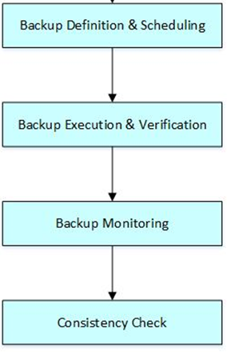
BACKUP STRATEGY
Proprietary of PT Soltius Indonesia

Slide 8
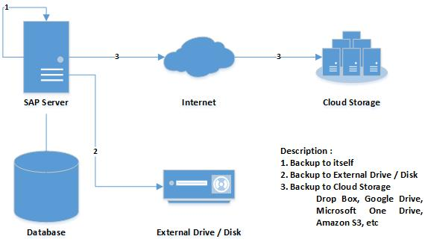
BACKUP SCENARIO
Proprietary of PT Soltius Indonesia

Slide 9
BACKUP RECOMMENDATION
Instance
  Weekly
Schema / Database
  Daily
DO NOT FORGET, MOVE THE FILE BACKUP OUT OF SERVER!!!
Proprietary of PT Soltius Indonesia

Slide 10
INSTANCE BACKUP
REMOTE SUPPORT PLATFORM (RSP)
PT SOLTIUS INDONESIA
SOHO CAPITAL @ PODOMORO CITY
15th Floor, Suite SC-1503-05
Jl. Letjen. S. Parman Kav. 28
Jakarta Barat 11470 - Indonesia
Office : +62 21 2934 5900

Slide 11

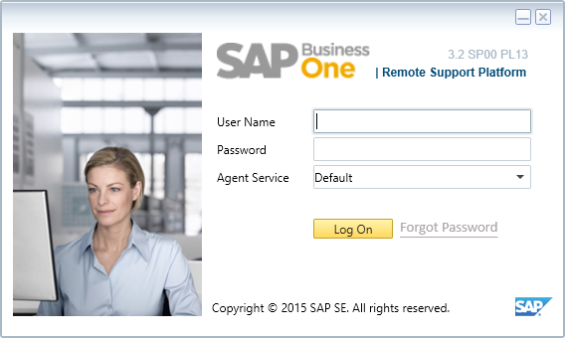

Step 1
Remote Support Platform – Log On
Remote Support Platform is SAP Platform to manage and monitor SAP Business One
Open Remote Support Platform
Log On to RSP by filling the User Name and Password
Proprietary of PT Soltius Indonesia

Slide 12
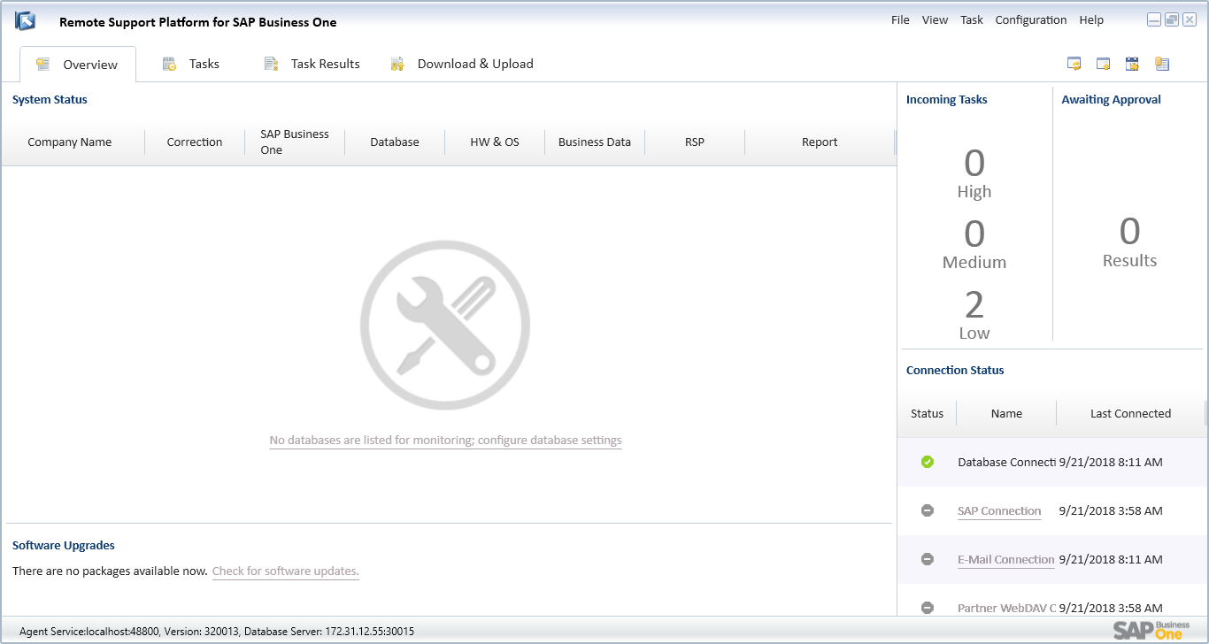
Step 2
Remote Support Platform
Hello Guys
After Log On into the Remote Support Platform, the following windows will be appeared
Click Configuration menu (highlighted)
CEO | Oliver Queen
Proprietary of PT Soltius Indonesia

Slide 13
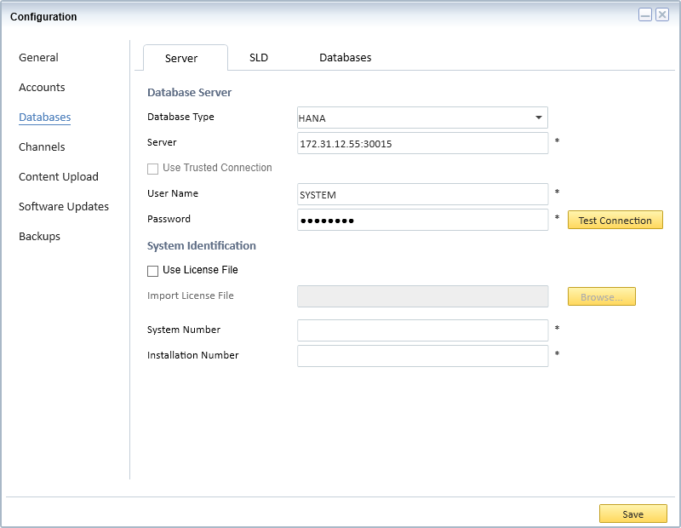
Step 3
Remote Support Platform – Configuration (Server)
The Configuration windows will be opened
In the Server Tab, fill the required fields such as Database Type, Server, User Name, and Password
Click Test Connection
Proprietary of PT Soltius Indonesia

Slide 14
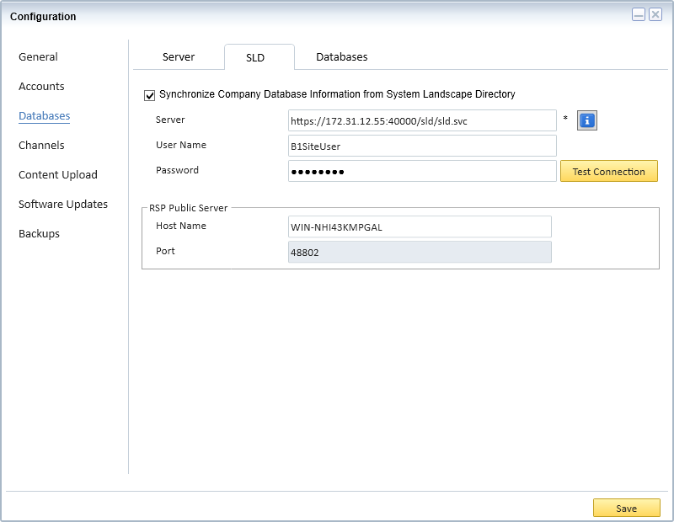
Step 4
Remote Support Platform – Configuration (SLD)
In the SLD Tab, fill the required fields such as Server, User Name, Password
Click Test Connection
Proprietary of PT Soltius Indonesia

Slide 15
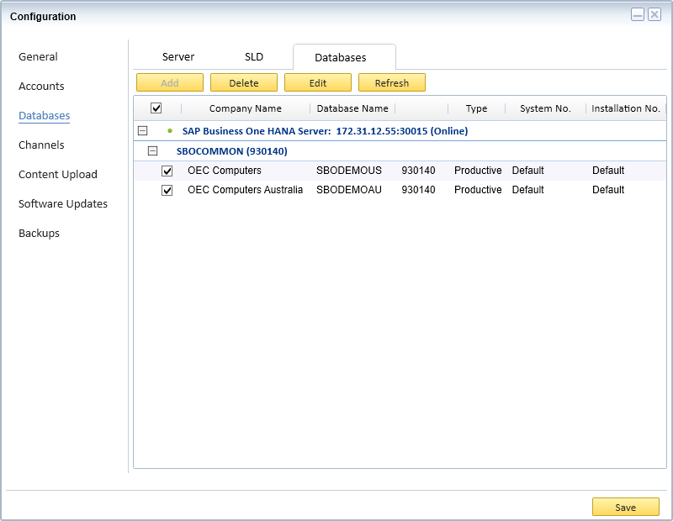
Step 5
Remote Support Platform – Configuration (Databases)
In the Databases Tab, choose which Databases will be configured especially for Backup Settings
Proprietary of PT Soltius Indonesia

Slide 16
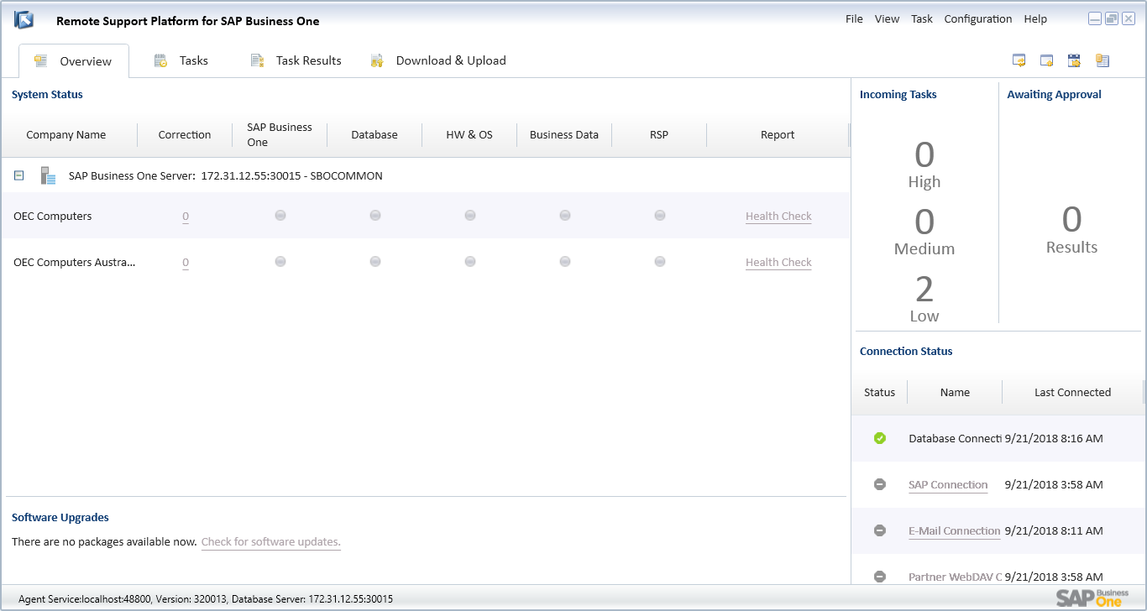
Step 6
Remote Support Platform
After the previous action, you can see that the databases selected in the configuration windows are shown at the Main Menu
Click Configuration → Backup Management
Proprietary of PT Soltius Indonesia

Slide 17
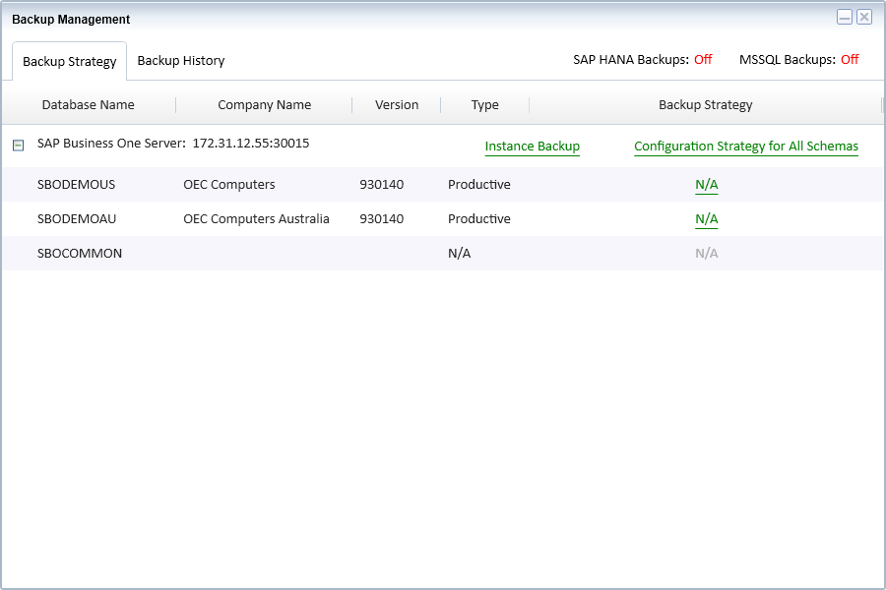
Step 7
Remote Support Platform – Backup Management
The following picture is Backup Management windows
Click on Instance Backup to open the Backup Strategy Settings
Proprietary of PT Soltius Indonesia

Slide 18
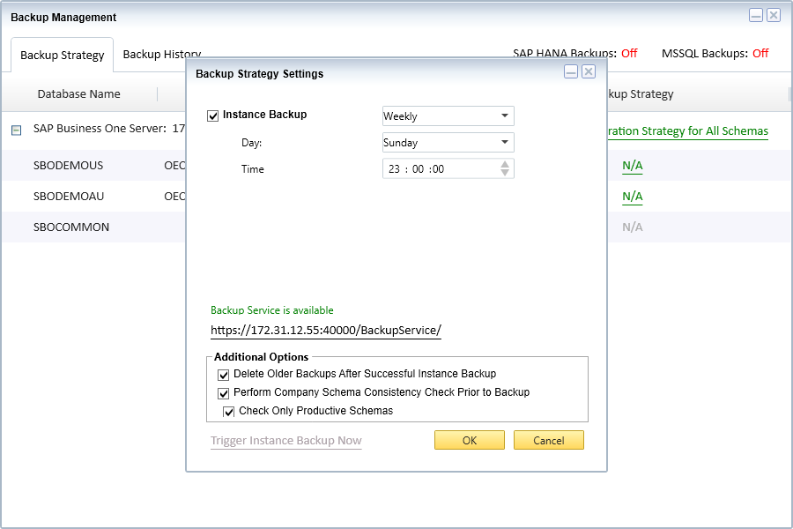
Step 8
Remote Support Platform – Backup Management – Backup Strategy Settings
After clicking “Instance Backup”, the following windows will be appeared
Configure the following settings according to user requirement regarding backup period
  User can choose to backup now using “Trigger Instance Backup Now”
  User can choose to backup using scheduler
Click OK to continue
Scheduler
Backup Now
Proprietary of PT Soltius Indonesia

Slide 19
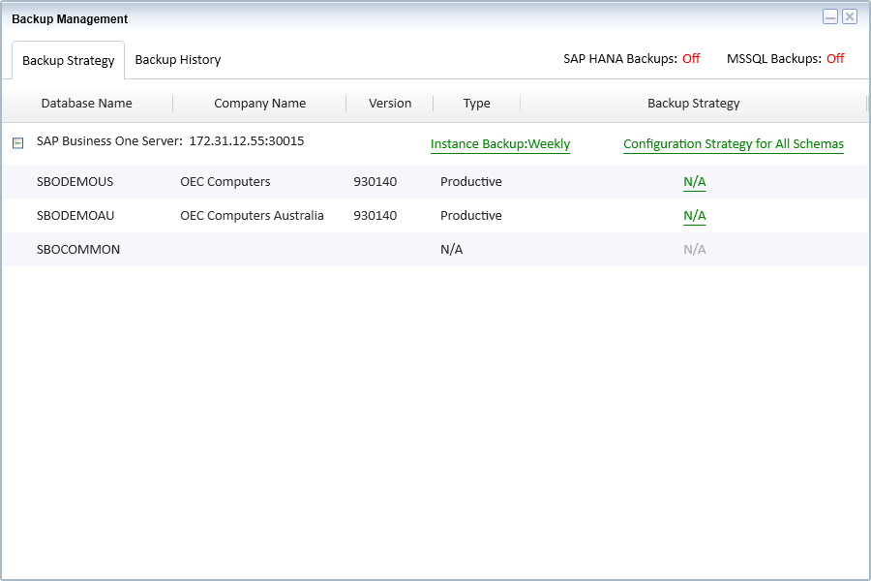
Step 9
Remote Support Platform – Backup Management – Instance Backup
The Instance Backup will change according to selected user parameter in the previous action
Proprietary of PT Soltius Indonesia

Slide 20
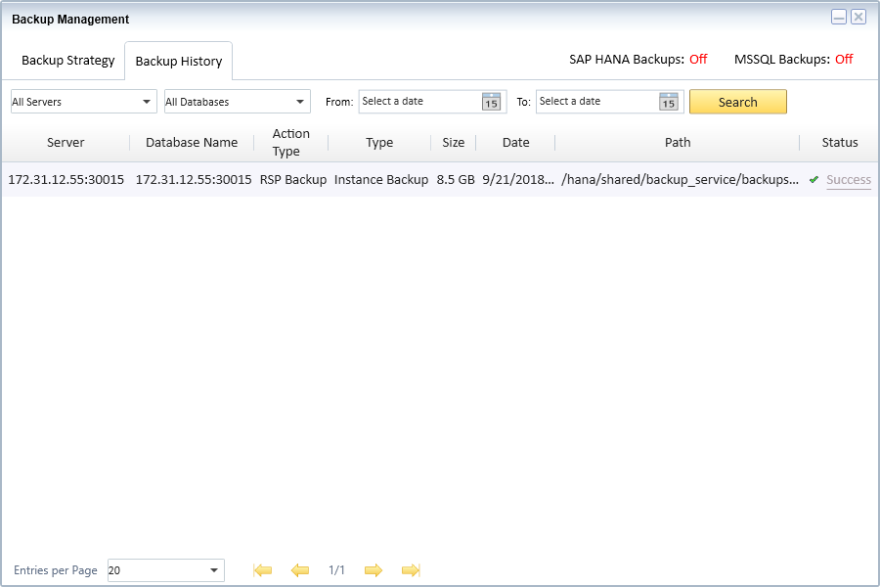
Step 10
Remote Support Platform – Backup Management – Backup History
In Backup History Tab, history of Backup Status which will always be updated according to latest Backup Action
Proprietary of PT Soltius Indonesia

Slide 21
BACKUP SCHEMA (DATABASE)
PT SOLTIUS INDONESIA
SOHO CAPITAL @ PODOMORO CITY
15th Floor, Suite SC-1503-05
Jl. Letjen. S. Parman Kav. 28
Jakarta Barat 11470 - Indonesia
Office : +62 21 2934 5900

Slide 22
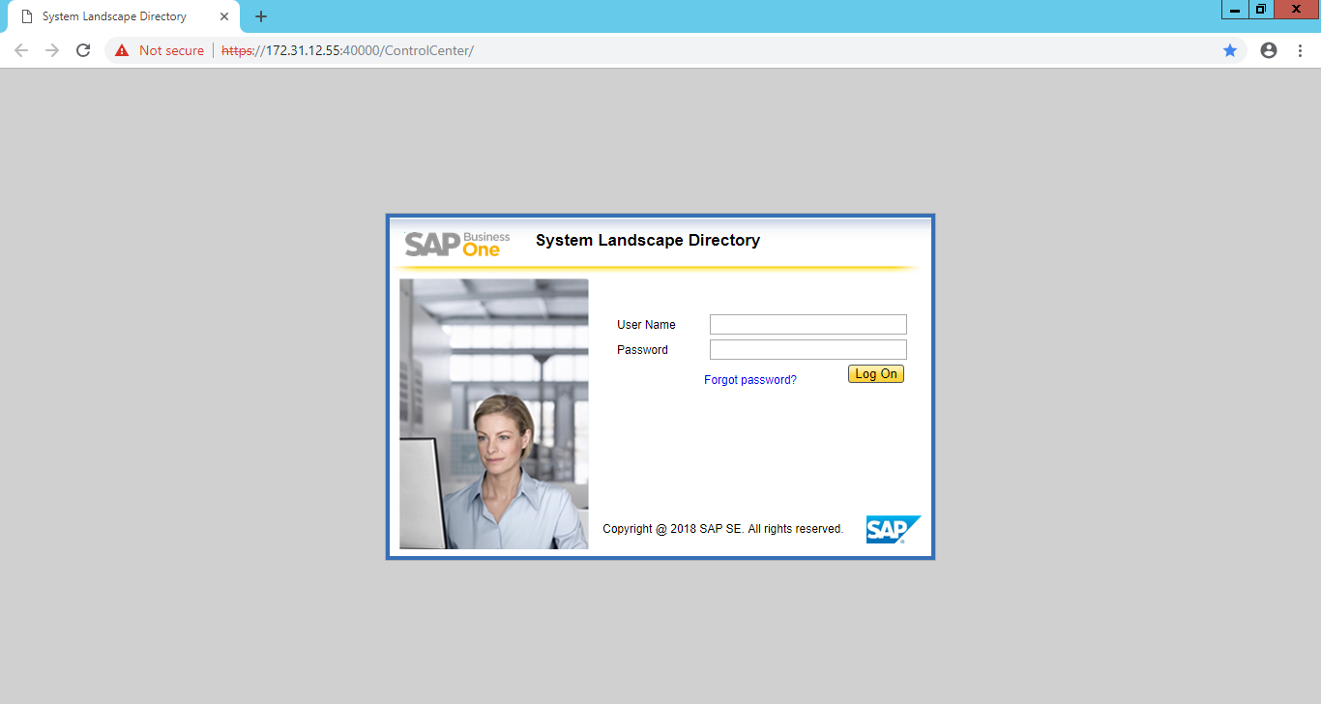
Step 1
System Landscape Directory – Log On
Hello Guys
Open System Landscape Directory from any web browser
Fill the User Name and Password
Click Log On to continue
CEO | Oliver Queen

Slide 23
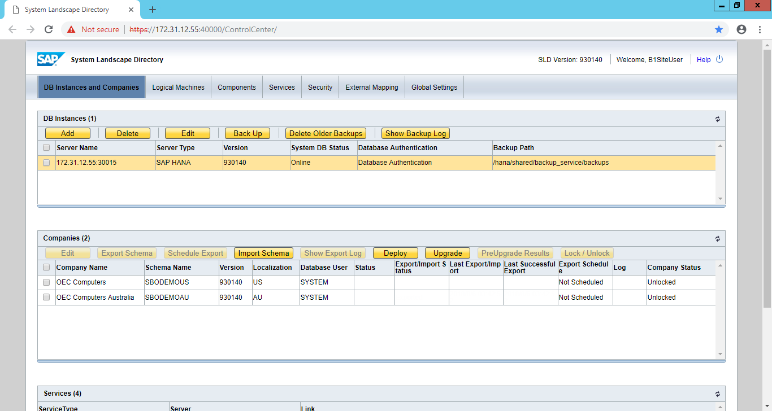
Step 2
System Landscape Directory
Hello Guys
After Log On into the System Landscape Directory, the following windows will be appeared
In the Companies section, user can see the available schemas (databases) currently registered in the system
CEO | Oliver Queen

Slide 24
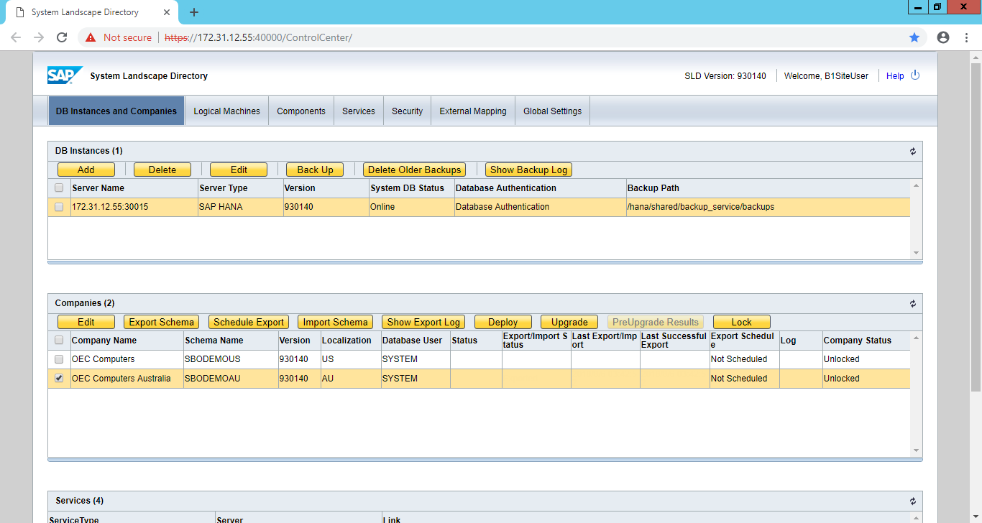
Step 3
System Landscape Directory – Export Schema
Hello Guys
In the Companies section, choose the schema (database) which is going to be exported
After the schema (database) is selected (highlighted & checked), choose Export Schema, better one by one
CEO | Oliver Queen

Slide 25
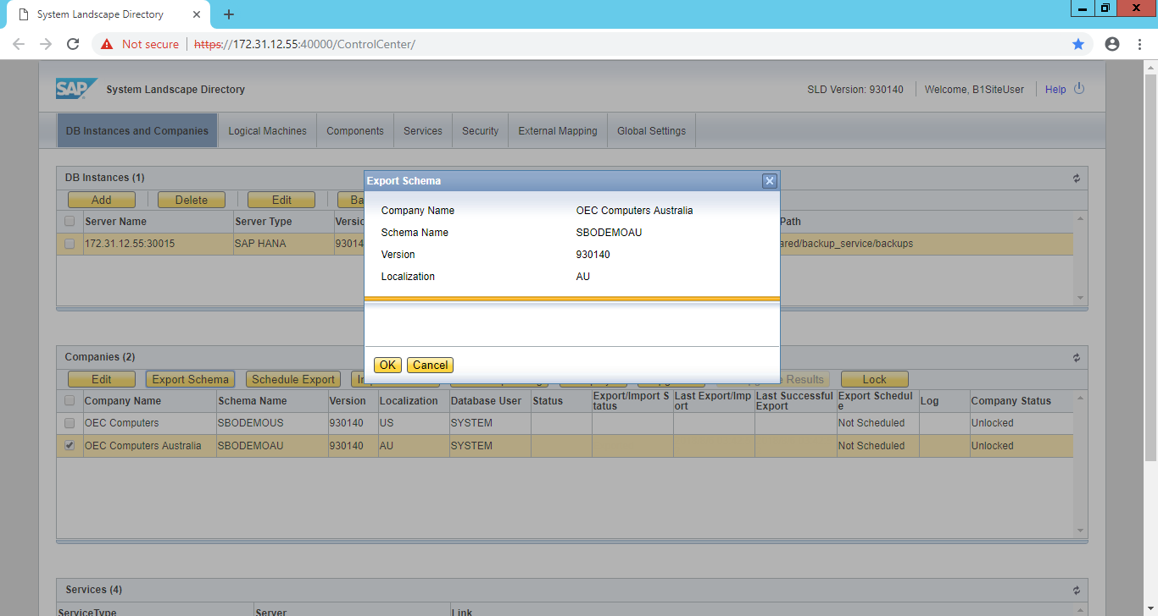
Step 4
System Landscape Directory – Export Schema Confirmation
Hello Guys
The following message will be appeared after choosing Export Schema
Click OK to continue
CEO | Oliver Queen

Slide 26
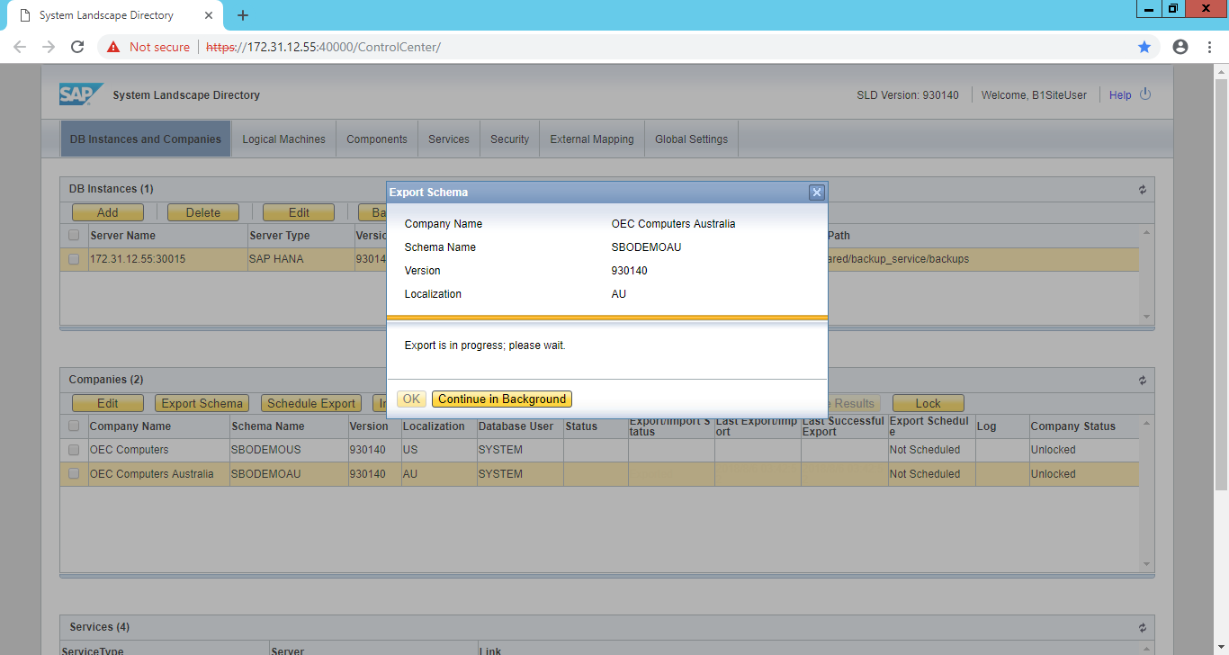
Step 5
System Landscape Directory – Export Schema is in Progress
Hello Guys
The following message will be appeared after choosing OK
Please wait until the Export Schema is finished
And Never choose Continue in Background
CEO | Oliver Queen

Slide 27
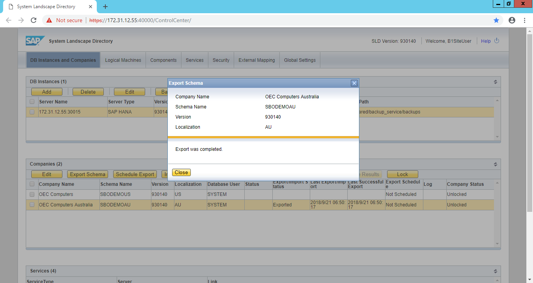
Step 6
System Landscape Directory – Export Schema Completed
Hello Guys
The following message will be appeared after Export Schema is Completed
Click Close to continue
CEO | Oliver Queen

Slide 28
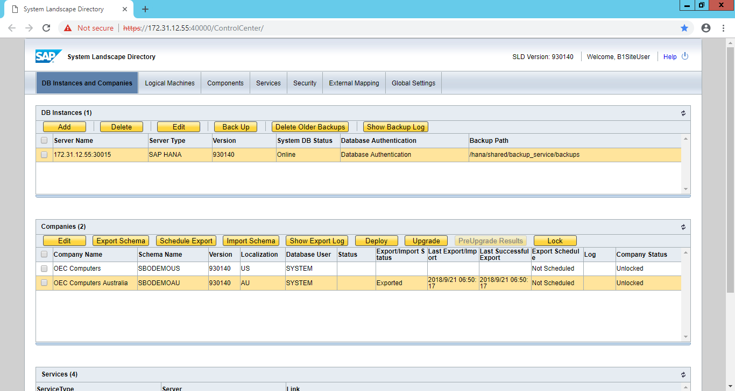
Step 7
System Landscape Directory – Export Schema Completed (Cont..)
Hello Guys
After Export Schema is completed, user can see some changes in the parameter showing the latest status of the schema
CEO | Oliver Queen

Slide 29

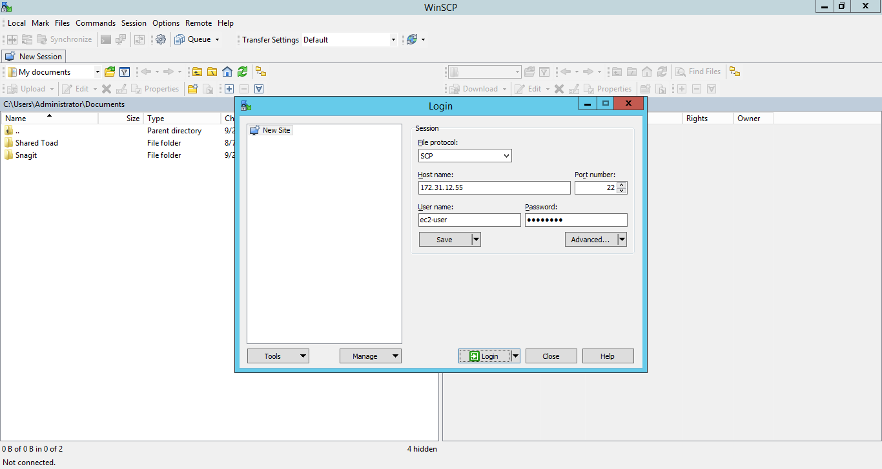
Step 8
WinSCP
WinSCP is an open source free SFTP client, FTP client, WebDAV client, S3 client and SCP client for Windows
Hello Guys
Open WinSCP
Login to WinSCP by filling the Host Name, Port Number, User Name and Password
CEO | Oliver Queen

Slide 30
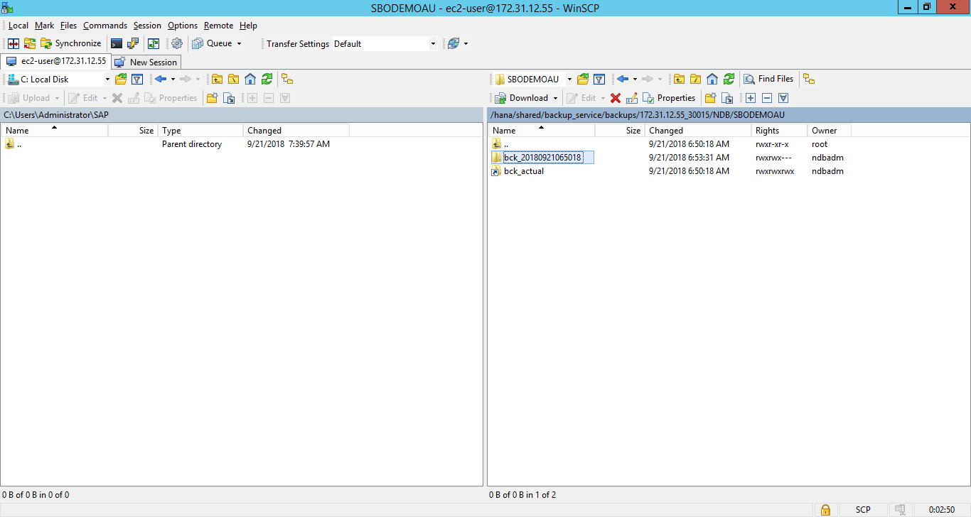
Step 9
WinSCP - Selecting Backup Schema (Database)
/hana/shared/backup_service/backups/[LINUX_IP]_30015/NDB/[DATABASE_NAME]/
Hello Guys
Left is Local (Windows OS) and Right is Remote (Linux OS)
After selecting the Backup Database that will be copied, user can download it by simply dragging the selected file to Local Computer
CEO | Oliver Queen

Slide 31
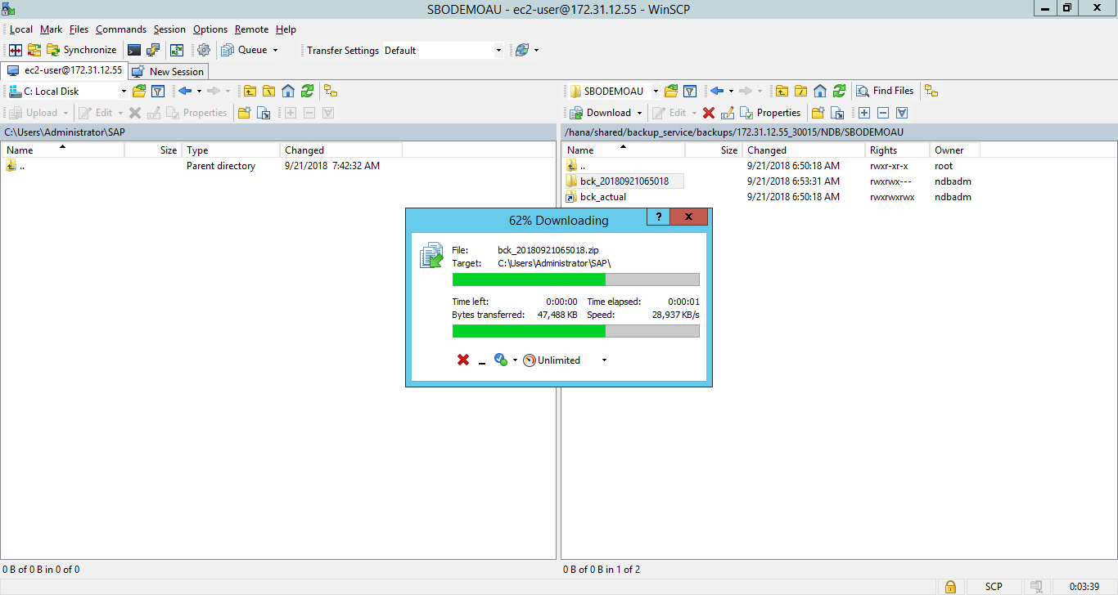
Step 10
WinSCP - Downloading Backup Schema (Database)
Hello Guys
The following windows will be appeared after the previous action is done
Please wait until the progress is finished
CEO | Oliver Queen

Slide 32
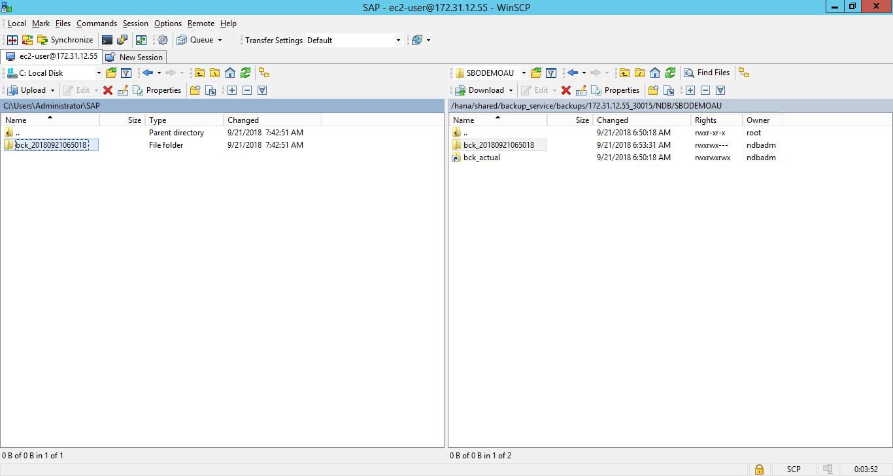
Step 11
WinSCP - Downloading Completed
Hello Guys
After the progress is finished, the selected file will be available in the following directory
CEO | Oliver Queen

Slide 33
REFERENCES
https://blogs.sap.com/2015/07/08/central-page-of-backuprecovery-topic-for-sap-business-one-version-for-sap-hana
Proprietary of PT Soltius Indonesia

Slide 34



THANK
YOU
For Your Attention
PT SOLTIUS INDONESIA
SOHO CAPITAL @ PODOMORO CITY
15th Floor, Suite SC-1503-05
Jl. Letjen. S. Parman Kav. 28
Jakarta Barat 11470 - Indonesia
Office : +62 21 2934 5900

